Slide 1
Assignment 02. Snapshots of rapid intensification of hurricane Ida
Eduardo Jimenez Hernandez, BE PhD student
ATMO555 Introduction to Atmospheric and Hydrologic Remote Sensing
University of Arizona
September 1, 2021

Slide 2
Method
Selected hurricane Ida
Date: August 28 and 29, 2021 (to observe rapid intensification)
Variables:
Download the images from GES DISC using a Windows Powershell script.
Using the Anaconda distribution of Python language, I created a conda environment
Installed libraries: GDAL, matplotlib, cartopy, imageio, spyder
Spyder IDE (matlab-like Python IDE)
Variable | Product
Precipitation | GPM_3IMERGHH

Slide 3
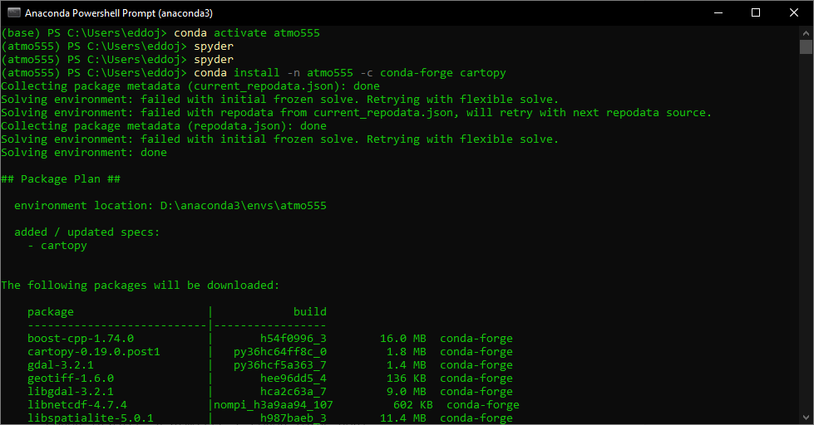
Conda environment
Install the libraries, for this project we need gdal, matplotlib and cartopy. I also installed spyder to edit the Python code.
conda install -n atmo555 -c conda-forge gdal
conda install -n atmo555 -c conda-forge matplotlib
conda install -n atmo555 -c conda-forge spyder
conda install -n atmo555 -c conda-forge cartopy
conda create --name atmo555
conda install -n atmo555 python=3.6
conda activate atmo555

Slide 4
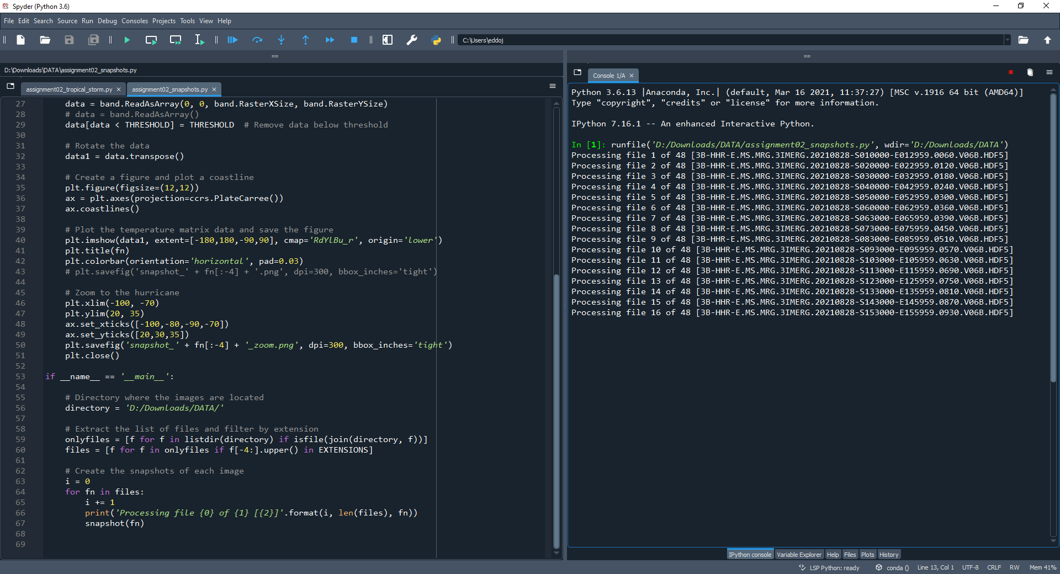
Code

Slide 5
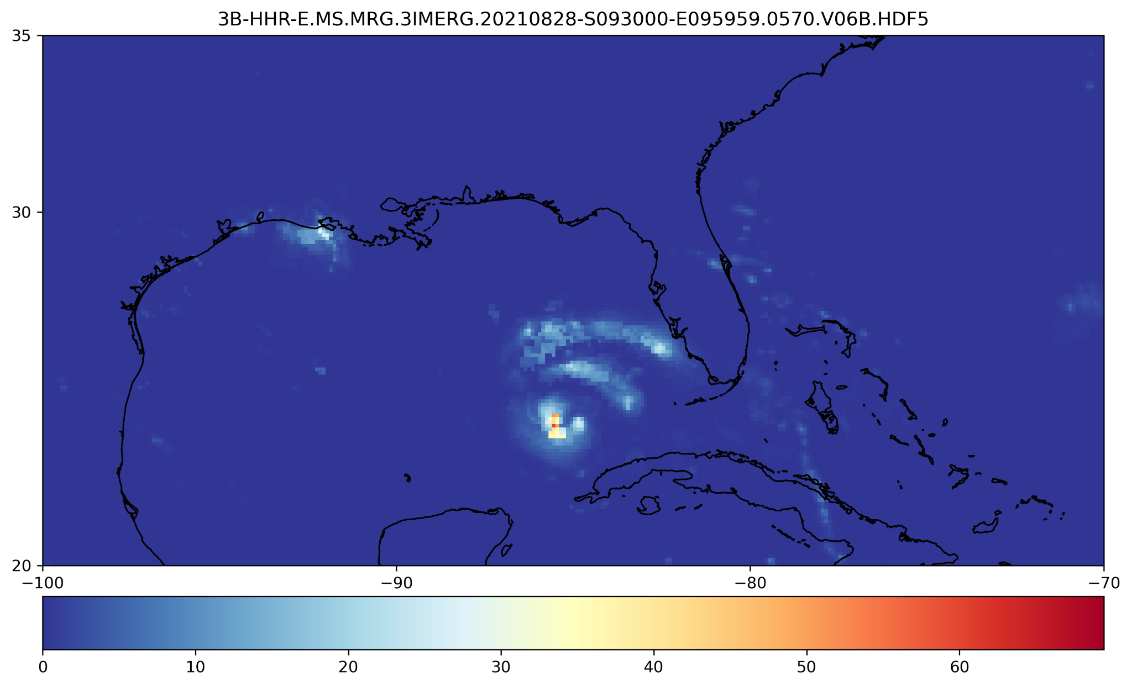
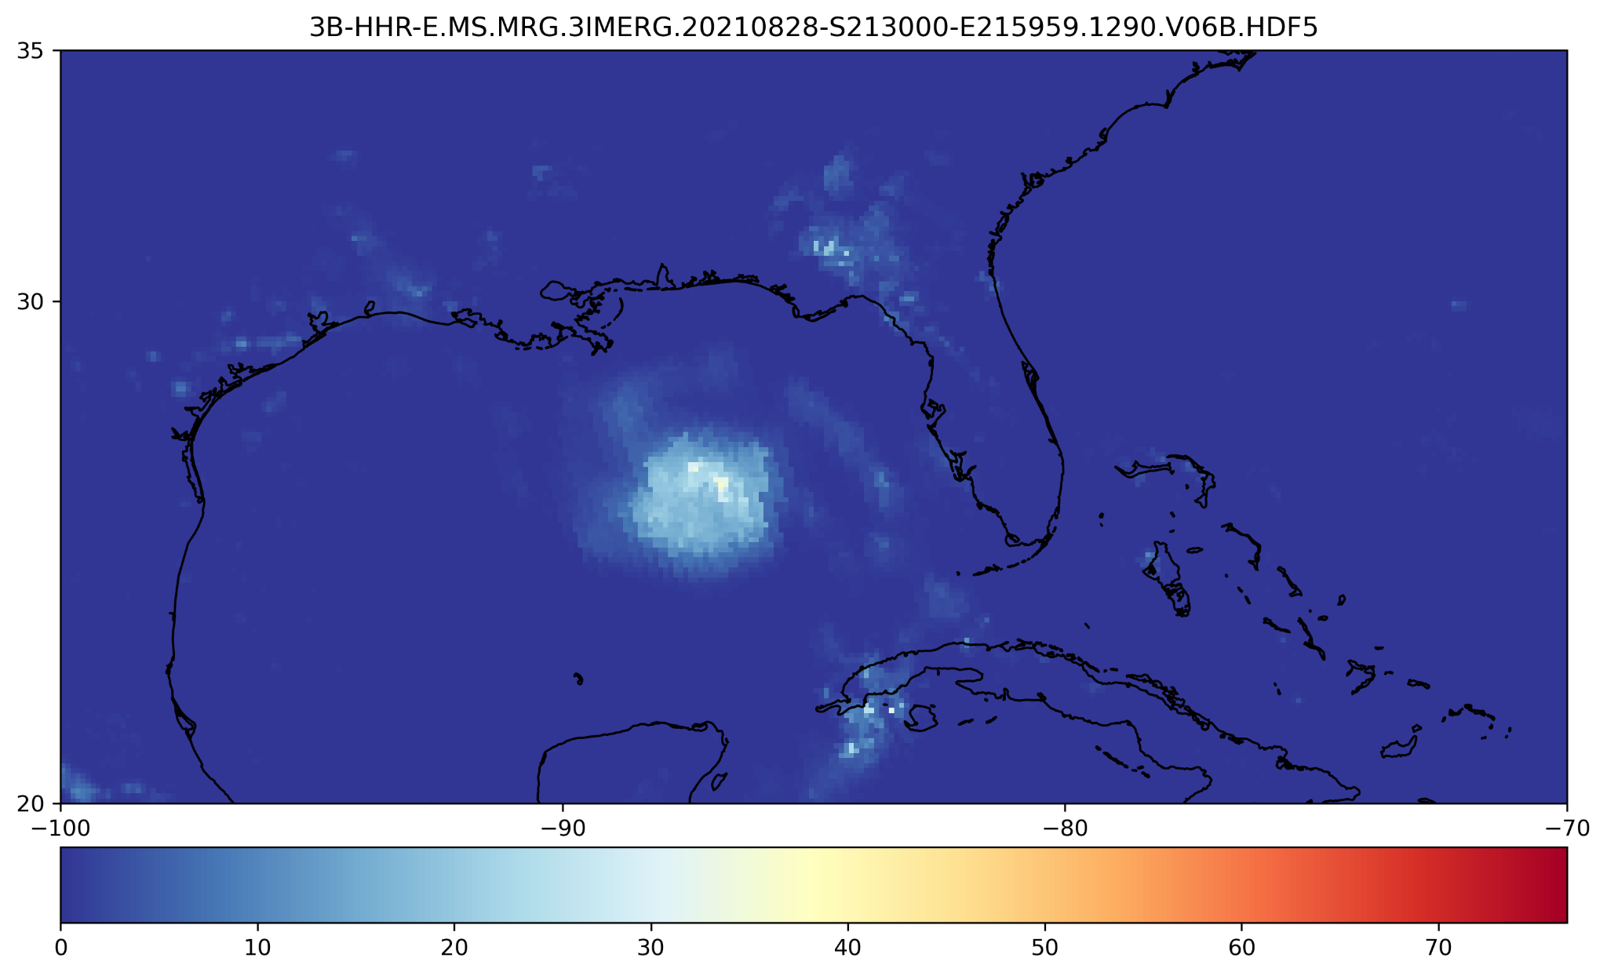
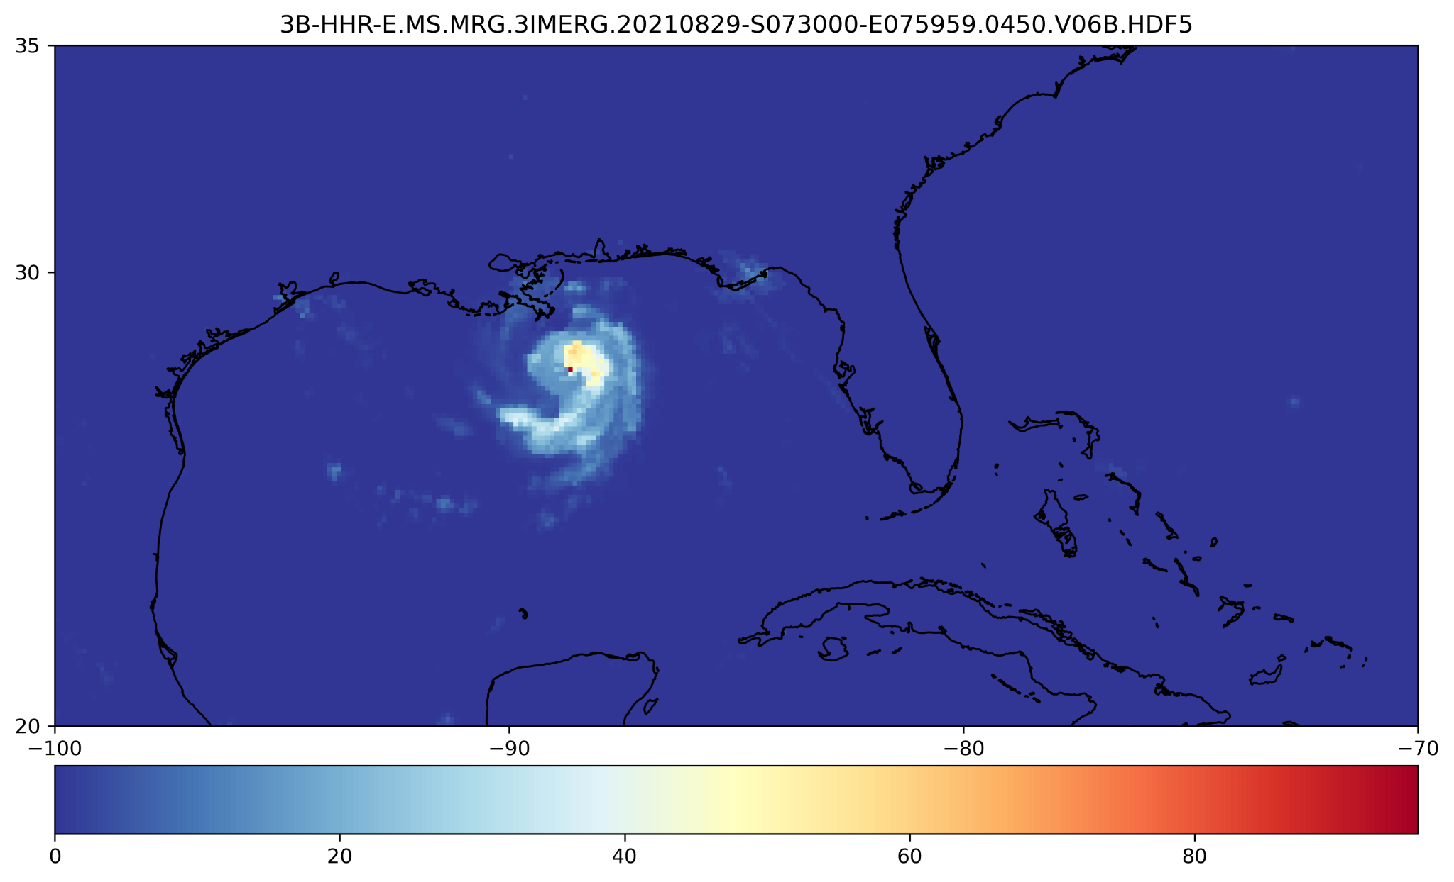
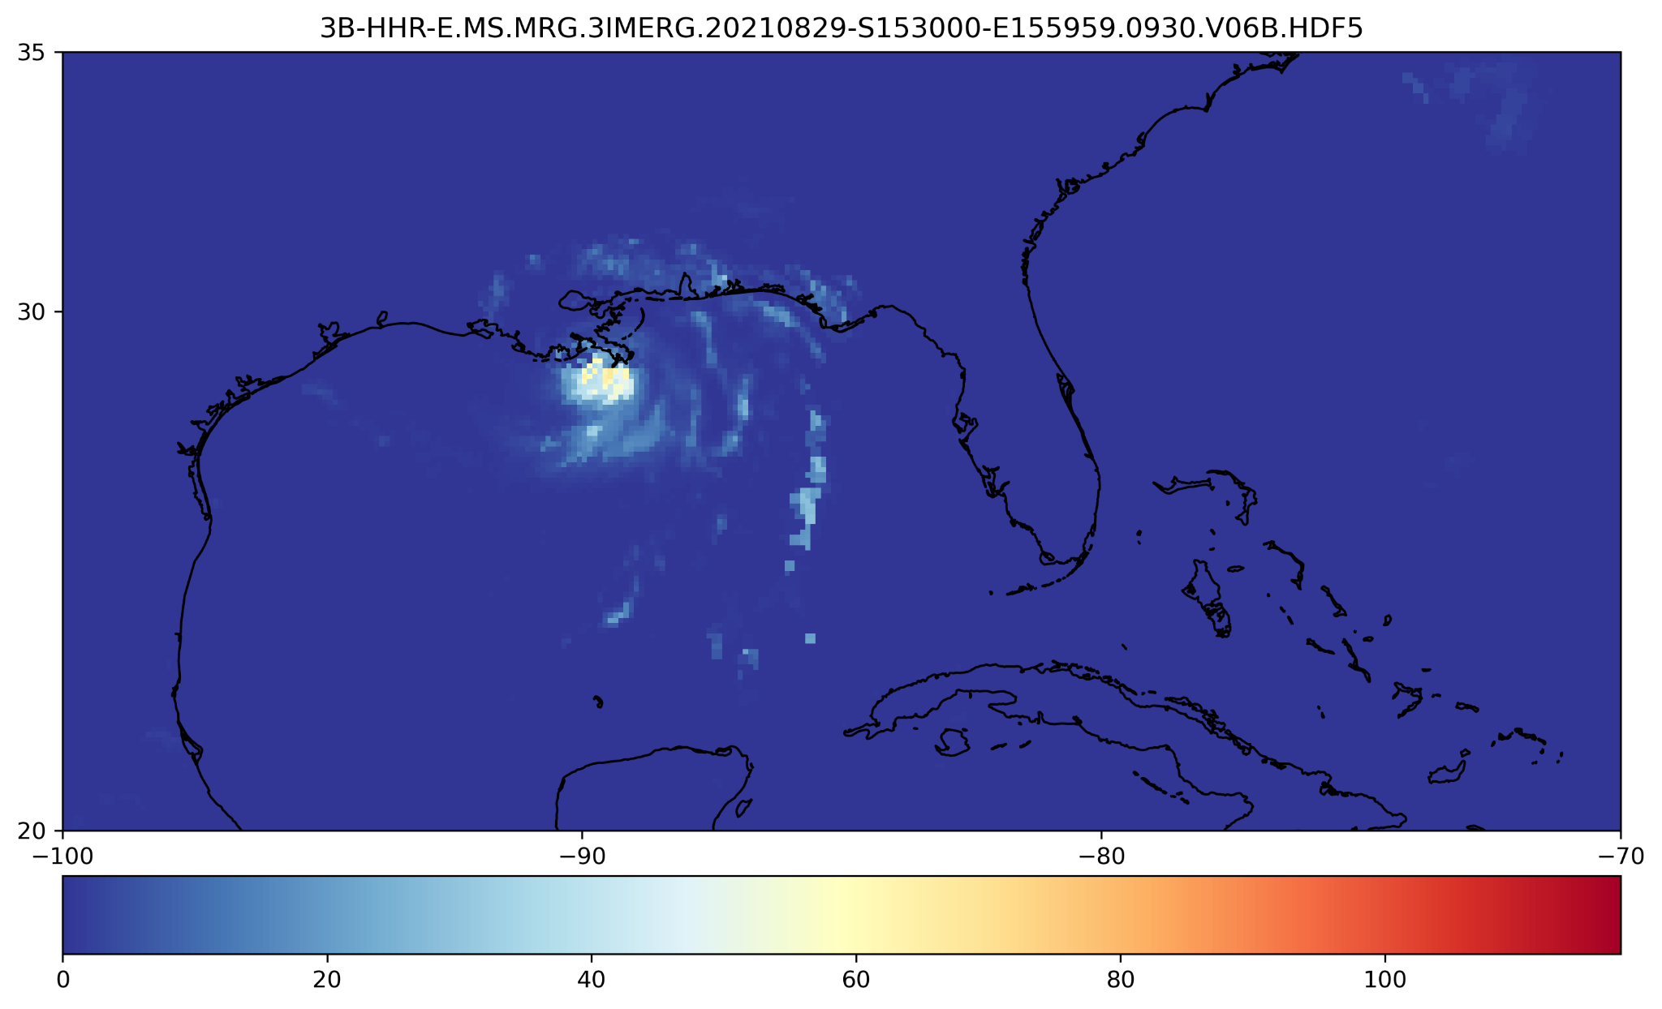
Snapshots

Slide 6
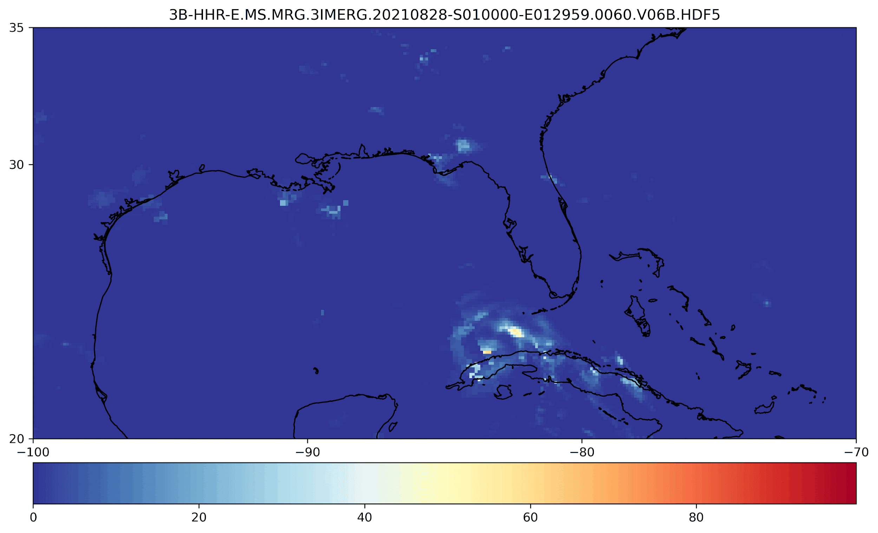
Precipitation Aug 28-29 @ 30 min

